Slide 1
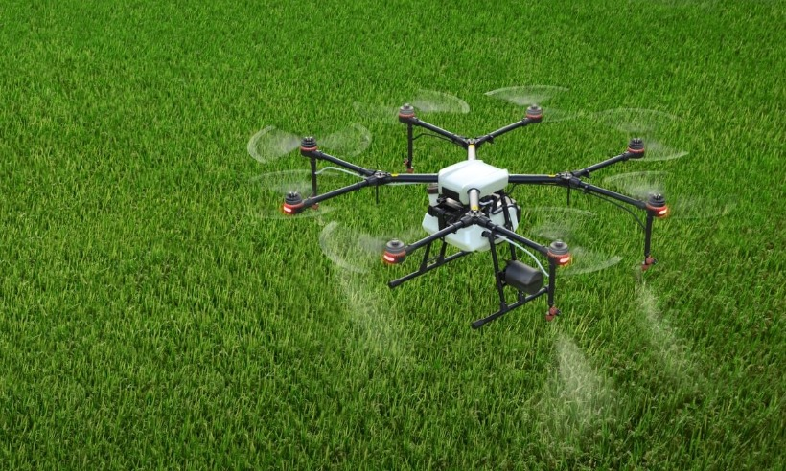
UAV
FPV (First-person view) system
Multiple PID controller
01
单击此处可编辑内容单击此处可
02
单击此处可编辑内容单击此处可
03
单击此处可编辑内容单击此处可
04
单击此处可编辑内容单击此处可
Notes:
UAV are remotely operated using an FPV (First-person view) system. The design control system is improved to enhance time response and dynamic performance, ensuring robust stability. Drone flight is autonomously managed multiple PID (proportional-integral-derivative) controllers

Slide 2
UAV
Camera , Sensors
Phantom 4 Pro Drone (DJI)
Detect UAV
Cameras, sensors, and irrigation tools
A four-wheel-drive drone
Specially used for irrigation
Irrigation UAV
Notes:
Our main drones are divided into two types: Detect UAV and Irrigation UAV
Detect UAV: contains camera and sensor which is a phantom 4 pro drone. It is used to detect terrain, humidity, and environment.
And used for precise irrigation.
Irrigation UAV : : contains camera, sensor and irrigation tools which is a four-wheel-drive drone
. Specially used for irrigation

Slide 3
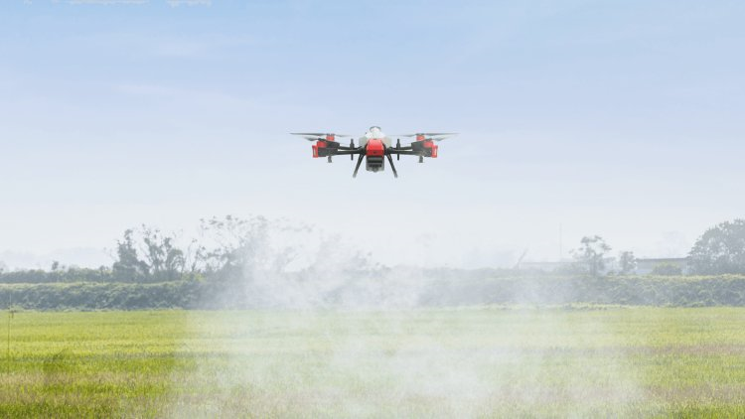
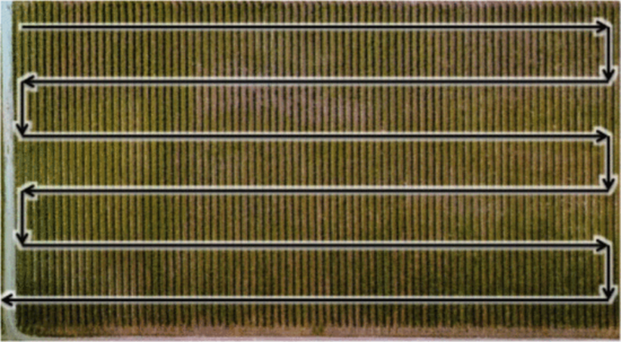
Irrigation UAV
Crop Water Stress Index (CWSI) images
Notes:
Irrigation UAV defines the location function of the irrigation drone based on the Crop Water Stress Index (CWSI) images derived from the detect UAV. These tracks are a grid network, the speed of the irrigating drone changes according to the crop water stress conditions, achieving precision irrigation in the end

Slide 4
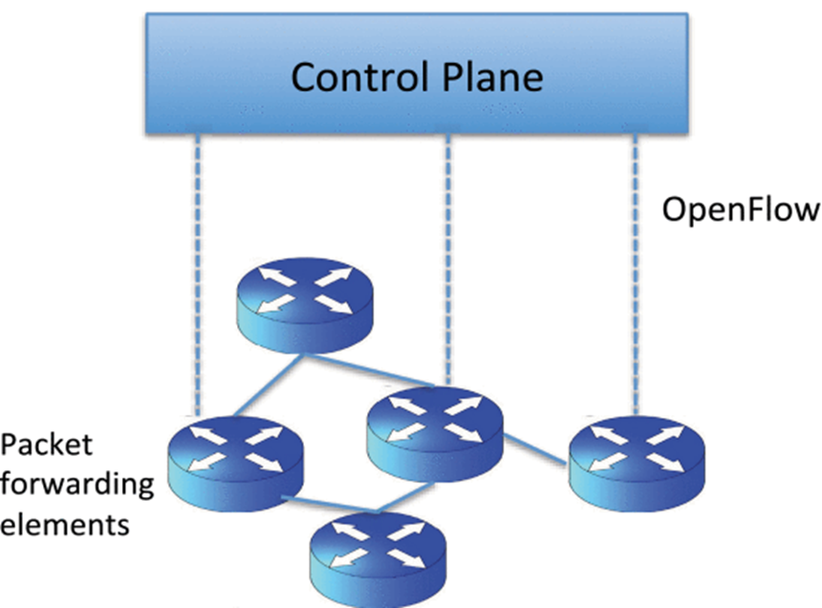
UAV Communication
SDN-
OpenFlow
Notes:
SDN (Software-Defined Networking) simplifies drone-operator communication, allowing easy deployment, network policy adjustments, and performance enhancements.
OpenFlow optimizes mobile network resources, enabling automated operations and quick service introductions. Additionally, a mobile management scheme using PMIPv6 and WAVE ensures seamless vehicular communication.

Slide 5
PART FOUR
Conclusion

Slide 6
Conclusion
EMG-UAV
integrating UAV technology with EMG-based controls for precision agriculture.
Address the SDGs of Zero Hunger, Good Health and Well-being, and Reduced Inequalities
Team collaboration
Notes:
Our Phase 2 exploration has led us to significant advancements in integrating UAV technology with EMG-based controls for precision agriculture. This approach not only promises to enhance crop productivity but also opens new pathways for employing disabled individuals, directly addressing the SDGs of Zero Hunger, Good Health and Well-being, and Reduced Inequalities. The collaborative effort amongs our team in developing the UAV and EMG components, respectively, underscores the power of interdisciplinary teamwork.

Slide 7
Reference List
[1 ] UM Rao Mogili, B B V L Deepak,Review on Application of Drone Systems in Precision Agriculture,Procedia Computer Science,Volume 133,2018,Pages 502-509,ISSN 1877-0509
[2 ] Tsouros, D.C.; Bibi, S.; Sarigiannidis, P.G. A Review on UAV-Based Applications for Precision Agriculture. Information 2019, 10, 349.
[3 ] Hopkins, M. The Role of Drone Technology in Sustainable Agriculture.
[4 ] Carolan, M. Publicising Food: Big Data, Precision Agriculture, and Co-Experimental Techniques of Addition: PublicisingFood. Sociol. Ruralis 2017, 57, 135–154.
[5 ] Brisco, B.; Brown, R.J.; Hirose, T.; McNairn, H.; Staenz, K. Precision Agriculture and the Role of Remote Sensing: A Review. Can.J. Remote Sens. 1998, 24, 315–327.
[6 ]L. F. Sanchez, H. Abaunza, and P. Castillo, “Safe navigation control for a quadcopter using user’s arm commands,” International Conference on Unmanned Aircraft Systems (ICUAS) June 13-16, 2017, Miami, FL, USA, 2017.
[7 ] E. M. Weiss, C. G. Kohler, J. Vonbank, E. Stadelmann, G. Kemmler, H. Hinterhuber, et al., "Impairment in emotion recognition abilities in patients with mild cognitive impairment, early and moderate Alzheimer disease compared with healthy comparison subjects," Am J Geriatr Psychiatry, vol. 16, pp. 974-80, Dec 2008.
[8 ] A. I. Meigal, S. Rissanen, M. P. Tarvainen, P. A. Karjalainen, I. A. Iudina-Vassel, O. Airaksinen, et al., "Novel parameters of surface EMG in patients with Parkinson's disease and healthy young and old controls," J Electromyogr Kinesiol, vol. 19, pp. e206-13, Jun 2009.
[9 ] C. DeLuca, R. LeFever, M. McCue, and A. Xenakis, “Behaviour of human motor units in different muscle during linear-varying contractions”, J. Physiol. (London), 329 (1982), pp. 113-128.
[10]Li Peilin. Employment and Institutional Change - The Job Search Process of Two Disadvantaged Groups [M]. Hangzhou: Zhejiang People's Publishing House, 2000.
[11]Zou Bo and Yang Lixiong: The Development of Welfare Enterprises and the Reform of Employment Policies for Persons with Disabilities, People's Publishing House, 2018 Edition, p. 137.
[12]Li Jing, "The Experience and Inspiration of Employment Support for People with Disabilities in the U.S.-Taking Boston as an Example," in Journal of Northwestern University (Philosophy and Social Science Edition), Vol. 49, No. 4, 2019.
[13]FAN Y and YIN Y, "Active and Progressive Exoskeleton Rehabilitation Using Multisource Information Fusion From EMG and Force-Position EPP," in IEEE Transactions onBiomedical Engineering, Dec. 2013, 60(12): 3314-3321.
[14]K. Zimenko, A. Margun and A. Kremlev, "Real-Time Classification for Robotics and HMI", 18th International Conference on Methods & Models in Automation & Robotics (MMAR), 2013.
[15]J. Bolin, J. Hoffman, C. Crawford, S. Beckmann and W. Macke, "Gesture-Based Control of Autonomous UAVs (Extended Abstract)", Proc. of the 16th International Conference on Autonomous Agents and Multiagent Systems (AAMAS 2017), pp. 1484-1486, 2017.

Slide 8
Reference List
[16]M. T. Wolf, C. Assad, M. T. Vernacchia, J. Fromm and H. L. Jethani, "Gesture-based robot control with variable autonomy from the JPL BioSleeve", 2013 IEEE International Conference on Robotics and Automation, pp. 1160-1165, 2013.
[17]S. Bitzer and P. V. D. Smagt, "Learning EMG control of a robotic hand: Towards Active Prostheses", IEEE International Conference on Robotics and Automation Orlando, 2016.
[18] Hafid, Abdelakram, et al. "EMG & EIMG measurement for Arm & Hand motions using custom made instrumentation based on Raspberry PI." 2020 2nd International Workshop on Human-Centric Smart Environments for Health and Well-being (IHSH). IEEE, 2021.
[19]Khan, Sagheer, Kiran Khurshid, and Muhammad Zceshan. "Emg data acquisition and flight control of quadcopter on different emg signals." 2019 14th Iberian Conference on Information Systems and Technologies (CISTI). IEEE, 2019.
[20]Mohammed, Noor, Zayed Ahmed, and Raquib-ul Alam. "Design and development of low-cost EMG amplifier for assistive technology." 2017 IEEE International Conference on Power, Control, Signals and Instrumentation Engineering (ICPCSI). IEEE, 2017.
[21]Hiraiwa, Akira, Katsunori Shimohara, and Yukio Tokunaga. "EMG pattern analysis and classification by neural network." Conference proceedings., IEEE international conference on systems, man and cybernetics. IEEE, 1989.
[22]Hafid, Abdelakram, et al. "EMG & EIMG measurement for Arm & Hand motions using custom made instrumentation based on Raspberry PI." 2020 2nd International Workshop on Human-Centric Smart Environments for Health and Well-being (IHSH). IEEE, 2021.
[23]Fontanilla, José A., Jesús D. Urbano, and A. Luque. "Low-cost voltage amplifier for biological signal acquisition through generic micro-electrode array." 2021 13th Spanish Conference on Electron Devices (CDE). IEEE, 2021.
[24]Sadikoglu, Fahreddin, Cemal Kavalcioglu, and Berk Dagman. "Electromyogram (EMG) signal detection, classification of EMG signals and diagnosis of neuropathy muscle disease." Procedia computer science 120 (2017): 422-429.
[z1] Abdullahi, H.S., Mahieddine, F. and Sheriff, R.E. (2015) ‘Technology impact on agricultural productivity: A review of precision agriculture using unmanned aerial vehicles’, Wireless and Satellite Systems, pp. 388–400. doi:10.1007/978-3-319-25479-1_29.
[26]C. Albornoz and L. F. Giraldo, "Trajectory design for efficient crop irrigation with a UAV," 2017 IEEE 3rd Colombian Conference on Automatic Control (CCAC), Cartagena, Colombia, 2017, pp. 1-6, doi: 10.1109/CCAC.2017.8276401.
[27]Nhamo L, Van Dijk R, Magidi J, Wiberg D, Tshikolomo K. Improving the Accuracy of Remotely Sensed Irrigated Areas Using Post-Classification Enhancement Through UAV Capability. Remote Sensing. 2018; 10(5):712. https://doi.org/10.3390/rs1005071
[z4]Spyridon G. Kontogiannis, John A. Ekaterinaris,Design, performance evaluation and optimization of a UAV,Aerospace Science and Technology,Volume 29, Issue 1,2013,Pages 339-350,ISSN 1270-9638,https://doi.org/10.1016/j.ast.2013.04.005.
[29]Anderson, B.D.O., Fidan, B., Yu, C., Walle, D. (2008). UAV Formation Control: Theory and Application. In: Blondel, V.D., Boyd, S.P., Kimura, H. (eds) Recent Advances in Learning and Control. Lecture Notes in Control and Information Sciences, vol 371. Springer, London. https://doi.org/10.1007/978-1-84800-155-8_2
[30]L. Gupta, R. Jain and G. Vaszkun, "Survey of Important Issues in UAV Communication Networks," in IEEE Communications Surveys & Tutorials, vol. 18, no. 2, pp. 1123-1152, Secondquarter 2016, doi: 10.1109/COMST.2015.2495297.

Slide 9
Thanks

